Slide 1
INVESTMENT ASSIGNMENT SUBMISSION
Name: Ravneet Singh

Slide 2
ABSTRACT AND COSTRAINTS
Spark Funds want to make investment in some companies.
Aim of this study is to help Spark Funds identify the most suitable investment trends globally according to given criteria/constraints
Below are Constraints which are needed to be catered while doing analysis:
Spark Funds wants to invest between 5 to 15 million (inclusive)
Spark Funds wants to invest in only English speaking Countries (due to convenience in interaction with English Language).
Spark Funds aim is to invest in sectors and companies which are heavily invested based upon collected previous data.
Based upon available data and above constraints, We need to choose the best investment type from below investment types
Seed
Angel
Venture
Private Equity
Eight main sectors are needed to be considered including ‘others’.

Slide 3
PROBLEM SOLVING METHODOLOGY
1. Business Understanding
2. Data Understanding
3. Data Preparation/ Cleaning
4. Data Analysis and Operations
5. Data Plotting
.

Slide 4
DATA ANALYSIS
BUSINESS UNDERSTANDING:
This includes the business study and constraints that are already defined in slide 2.
Goals of data analysis are defined crisply.
DATA UNDERSTANDING:
This includes the study of data files which are “companies”, “rounds2” and “mapping”.
Identifying unique identity in above named files. Such as “companies” data file has a unique identity” permalink”, “rounds2” has “company_permalink”.
Few trends were identified like same company can have investment on different types and sectors. Same company can be present in many countries but with different permalink.
Special character are present in company “permalink” column.
Not all main sectors are present in category list present in company
Methods like data frame describe, info and summary were used to identify columns and their data types.
NaN values are observed which would be dealt with during data cleaning phase.

Slide 5
DATA ANALYSIS
DATA PREPARATION/ CLEANING:
“Palmos” encoding is used to read datafiles into python data frames.
“Palmos” works nicely when converting words with special character into lower case.
Checking for the unique companies that are present in “company” and “rounds2” files.
We decided not to remove “closed” companies at this point, as some valid investments were made in past which we don’t want to rule out. While selecting the companies we’ll opt-out the “closed” ones.
NaN values for “raised_amount_USD” is around 17% of total data. Since the standard deviation is big therefore data spread is high, predicting a value for imputation may not be accurate so we have decided to drop the NaN containing rows.
Since data frame is not using much memory, we have decided to keep all columns.
We decided to remove outliers by removing one percentile from above and lower limits.
NULL values in “category_list” is also removed as their percentage is small.
We observed that mapping file category list has few unclean categories where '0' is present instead of 'na’. So we decided to replace these '0's with 'na'.

Slide 6
DATA ANALYSIS
DATA ANALYSIS & OPERATIONS:
After getting data for each investment type individually, we noticed that difference between quartile values and median is high.
Also, the standard deviation is large for each type.
This shows the spread of data is big, and median is more appropriate for considering average.
Above points are also seen evidently from box plot of each investment type.
While picking the top 9 countries, we have picked the top3 English speaking (official and working language) countries.
In mapping files, each of the primary sector have ONE main sector from EIGHT main sector. Blank/NaN values will be filtered out when joining with the mainframe.
We checked the most heavily invested main sector in these top 3 countries for its investment type which range within 5-15 Million USD.

Slide 7
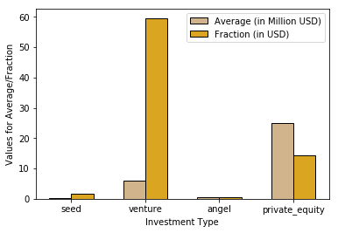
DATA PLOTTING
PLOT FOR GETTING SUITABLE INVESTMENT TYPE:
This plot shows the average investment in each investment type as well as the total fraction of each investment type.
“Venture” has the most appropriate average for Spark Funds constraints of 5-15 Million USD.
Total fraction of investment done for “Venture” is also high.
So “Venture” is most suitable amongst all and can be used for Spark Funds as the suitable investment type.

Slide 8
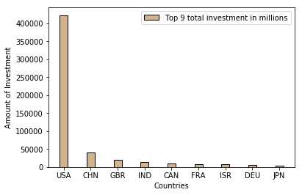
DATA PLOTTING
PLOT SHOWING TOP 9 COUNTRIES WITH RESPECT TO TOTAL INVESTMENT:
From the graph, it is clear that USA, CHN, GBR, IND and CAN are amongst the top 5 countries.
As per SPARK FUNDS constraints, we need to choose the countries that are having “English” as their official language.
CHN is not included because, as per the link below:
https://en.wikipedia.org/wiki/List_of_territorial_entities_where_English_is_an_official_language/
CHN doesn’t appear in “English” as its working or official language list.
So USA, GBR(United Kingdom) and IND comes out to be the top 3 countries that satisfies the above constraints.

Slide 9
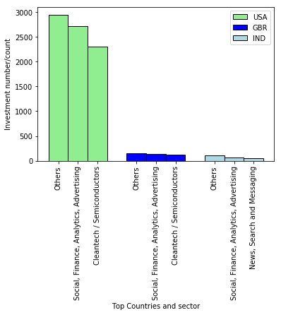
DATA PLOTTING
PLOT SHOWS NUMBER OF INVESTMENTS IN TOP 3 SECTORS FOR EACH TOP 3 COUNTRIES:
We have used investment type as the criteria to choose top countries and sectors.
This clearly shows that the USA is the country with highest investment.
Best main sectors amongst all 3 countries is “Others”.
As per the graph, the second best main sector for all 3 countries is same namely, “Social, Finance, Analytics, Advertising”.
The third best main sector for the first 2 countries is “Cleantech/ Semiconductors” whereas for the third country “News, Search and Messaging” is the third best main sector.

Slide 10
CONCLUSION
Thus it is concluded from analysis made in above mentioned slides, that :
As per SPARK FUNDS constraints “Venture” is the most suitable investment type amongst all namely, Seed, Venture, Private Equity, Angel.
Most heavily invested countries as per constraints are USA, GBR, IND.
And most heavily invested main sectors across above mentioned countries are “Others”, “Cleantech/ Semiconductors”, “Social, Finance, Analytics, Advertising”, “News, Search and Messaging”, and “Entertainment”.
There are around 150+ companies in top sector calculated above which has highest investment for the USA. Names of the companies are listed in ‘Investments’ excel file.
It is noticeable that large number of companies with investment of 15 Million USD are present, if less than 15 Million USD is taken into account then the number is considerably reduced to less than 5.

